Slide 1

Department of Computer Science & Engineering CardioSmart 360 Batch no. B - 48 1. 2211CS010547 (SUBHAPREET PATRO) 2. 2211CS010546 (SUBHAM PATNAIK) 3. 2211CS010553 (SYED SHAHANAWAZ HUSSAIN) 4. 2211CS010262 (KALERU VASUNDHARA) Guide MR. G. RAJU
Maisammaguda, Kompally, Medchal - Malkajgiri District Hyderabad - 500100, Telangana State. www.mallareddyuniversity.
(Telangana State Private Universities Act No. 13 of 2020 &
G.O.Ms. No. 14, Higher Education (UE) Department)

Slide 2
Table of Contents
Introduction
Limitations of Existing Systems
Problem Statement (Abstract)
Methodology (Architectural/Workflow Diagram)
UML Diagrams
Conclusion

Slide 3
Introduction
In the realm of modern healthcare, the ability to accurately predict and diagnose heart disease is crucial for effective treatment and patient management. To address the growing challenges in this field, we have developed CardioSmart 360, an innovative heart disease prediction system that harnesses the power of advanced machine learning techniques to deliver precise and timely insights.
CardioSmart 360 stands out by integrating a prediction model that meticulously analyzes a broad spectrum of patient attributes. These include age, gender, chest pain type, cholesterol levels, fasting blood sugar, maximum heart rate, exercise-induced angina, the slope of the peak exercise ST segment. By processing these critical factors, the system generates a comprehensive risk assessment that assists clinicians in making well-informed decisions about patient care.What truly sets CardioSmart 360 apart is its ability to visually represent its predictions, offering a clear and intuitive graphical analysis of the patient's heart disease risk. These visualizations, driven by machine learning algorithms, provide an accessible way for healthcare professionals to interpret complex data and communicate findings effectively to patients.

Slide 4
Introduction
This graphical representation not only enhances understanding but also helps in tracking progress and making data-driven adjustments to treatment plans.
Machine learning lies at the core of CardioSmart 360's capabilities. The system continuously learns from new data, refining its predictions and becoming more accurate over time. This dynamic approach ensures that the model remains up-to-date with the latest medical research and clinical data, making it a powerful tool for predictive analytics in cardiology.
By combining the precision of machine learning with comprehensive data management, CardioSmart 360 exemplifies the transformative potential of technology in medical diagnostics. It is not just a tool for prediction but a holistic platform designed to enhance patient care, streamline clinical workflows, and ultimately improve outcomes in the fight against heart disease. With CardioSmart 360, clinicians can now leverage the power of artificial intelligence to make more informed decisions, leading to better patient outcomes and a brighter future for cardiovascular health.

Slide 5
Limitations of Existing System
No Visualizations :The lack of graphical representations for risk assessments limits clinicians' ability to communicate complex data effectively to patients, making it harder to explain risk factors and treatment options.
Minimal / no option to save user data:The system's limited capacity to save and manage user data restricts the continuity of care, as clinicians cannot easily track changes in a patient’s condition over time.
Limited Usability for Clinicians: Some systems require a high level of technical knowledge to operate, making them less user-friendly for healthcare providers who may not be familiar with complex machine learning or data science concepts.
Inability to Track Progress Over Time: Most existing systems do not allow for the tracking of patient health trends over time. This limits clinicians’ ability to adjust treatment plans dynamically based on evolving patient conditions.

Slide 6
Problem Statement (Abstract)
In the realm of medical diagnostics, the timely and accurate analysis of patient data is crucial for effective treatment and management. Addressing the challenges associated with data management and prediction, we developed a Python-based heart disease prediction system leveraging advanced machine learning techniques.
Our system integrates a comprehensive prediction model to assess the likelihood of heart disease based on various patient attributes, including age, sex, chest pain type, cholesterol levels, fasting blood sugar, electrocardiographic results, maximum heart rate, exercise-induced angina, ST depression, the slope of the peak exercise ST segment, the number of major vessels coloured by fluoroscopy, and thalassemia status. By incorporating these parameters, the model provides a robust prediction mechanism that aids clinicians in making informed decisions.
The integration of machine learning and database management within a single platform highlights the potential for technology to enhance medical diagnostics and patient care.

Slide 7
Methodology (Architectural/Workflow Diagram)
PATIENT REGISTRATION
PATIENT FEED VALUE
DATA COLLECTION
DATABASE
PREDICTION
EXTRACTION OF DATA
CLASSIFICATION
PROBABILITY AND POSSIBILITY

Slide 8
UML Diagrams
USECASE DIAGRAM
Registration
Enter details
Collect data
USER
Match values
SERVER
Classify data
Predict disease
Send the report

Slide 9
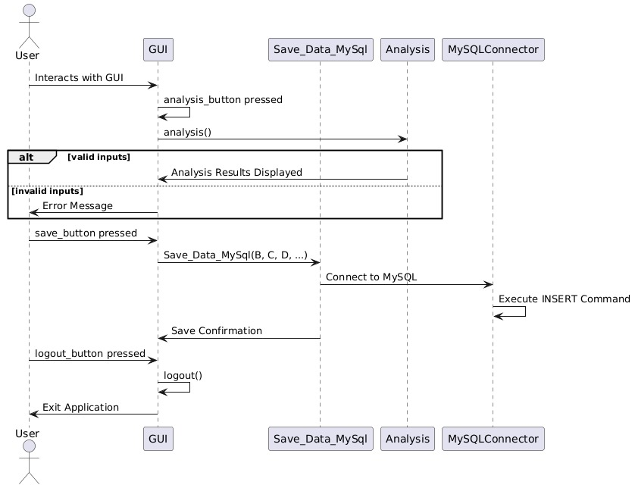
UML diagrams
SEQUENCE DIAGRAM

Slide 10
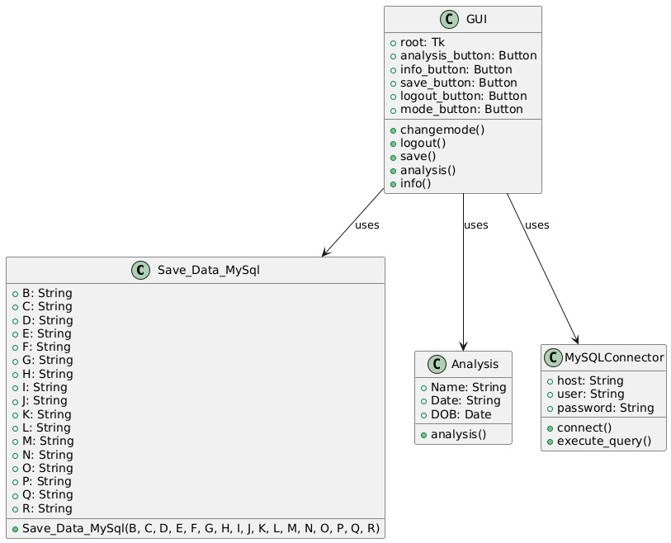
UML diagrams
CLASS DIAGRAM

Slide 11
Conclusion
CardioSmart 360 revolutionizes heart disease prediction by integrating advanced machine learning algorithms with comprehensive patient data analysis. By considering a wide range of patient attributes and continuously learning from new data, the system provides highly accurate, real-time risk assessments that empower clinicians to make more informed decisions. Its user-friendly graphical visualizations simplify complex medical data, enhancing communication between healthcare professionals and patients. With its adaptive capabilities and holistic approach to heart disease diagnostics, CardioSmart 360 sets a new standard for predictive analytics in cardiology, improving both clinical workflows and patient outcomes.

Slide 12
Hardware and software requirements
Hardware Requirements
Server: Multi-core processor, 16GB RAM, 1TB SSD, optional GPU.
Workstation: Quad-core processor, 16GB RAM, 512GB SSD.
Software Requirements
OS: Windows/macOS/Linux (workstation).
Database: MySQL.
Machine Learning: Python.
Web Development: Tkinter.

Slide 13
Medical Parameters required
age - age in years
sex - sex (1 = male; 0 = female)
cp - chest pain type (0 = typical angina; 1 = atypical angina; 2 = non-anginal pain; 3 = asymptomatic)
chol - serum cholestoral in mg/dl (in mm Hg on admission to the hospital)
fbs - fasting blood sugar > 120 mg/dl (1 = true; 0 = false)
restecg - resting electrocardiographic results (0 = normal; 1 = having ST-T; 2 = hypertrophy)
thalach - maximum heart rate achieved
exang - exercise induced angina (1 = yes; 0 = no)
oldpeak - ST depression induced by exercise relative to rest
slope - the slope of the peak exercise ST segment (0 = upsloping; 1 = flat; 2 = downsloping)
ca - number of major vessels (0-3) colored by flourosopy
thal - 0 = normal; 1 = fixed defect; 2 = reversable defect

Slide 14
THANK YOU

